Slide 1


The P.A.C.M.A.N Project
Madrid in Black
Madrid in Black​

Slide 2

Introduction
What is P.A.C.M.A.N?
Purpose of the Project
The Idea
The P.A.C.M.A.N Project
Madrid in Black​

Slide 3
Schools and Students
Madrid in Black
Schools and Countries
Students
Carlow Institute of Further Education and Training from Carlow, Ireland.
IES El Lago from Madrid, Spain
SPS Na Proseku from Prague, Czech Republic
Hälsinglands Utbildningsförbund from Sörderhamn, Sweden
Ireland – Dan Besleaga and Shane Pitman
Spain - Sergio Castillo and Mateo Sagaseta
Czech - Michael Kazda and Michal Dvořák
Sweden – Johan Larm and Knut Lundgren
Madrid in Black​

Slide 4


The Companies
BInfluencer and Grupo OneTec
Support and Supervision
BInfluencer
Grupo OneTec
Madrid in Black​

Slide 5

Organization and Skills
Organization
First Stage
Second Stage
Third Stage
Fourth Stage
Fifth Stage
Final Stage
Responsibility
Learn Python
Make the Spider
Store it in MongoDB
Make Graphs
Organization and Responsibility
Madrid in Black​

Slide 6

Organization and Skills
Communication
Initiative
Problem Solving
Conflict Result & Critical Thinking
Decision Making
Willingess to Learn & Enthusiasm
Teamwork & Cooperation
European Culture
Madrid in Black​

Slide 7

The Objective
Tasks, Ideas and Teamwork.
The Main Goal
Crawler/Spider
TiKToK
Scraping
MongoDB
Pandas and Matplotlib
Creating Bridges
Madrid in Black​

Slide 8

Technologies
We have used several kinds of technology in this project.
Python
MongoDB
Pandas
Matplotlib
Jupyter Notebook
GitHub
Microsoft Teams
Madrid in Black​

Slide 9

Problems and Solutions
Deploy
The Main Problem
The Signature
Graphs
Coding
We haven't had any programming problems other than the typical mistakes that were solved together by helping each other.
Madrid in Black​

Slide 10

System Testing
We have used MongoDB Compass which is program that allows any user within our team to visualize and explore our data scraped and be assured if they had been inserted into the database.
We have used Jupyter Notebook to made some tests about the graphs and data views because it is good program to show them. In addition, when an alert is thrown is displayed more clearly than by console and is easier to detect the mistake
Tested that everything has been stored correctly and testing the graphs.
Madrid in Black​

Slide 11
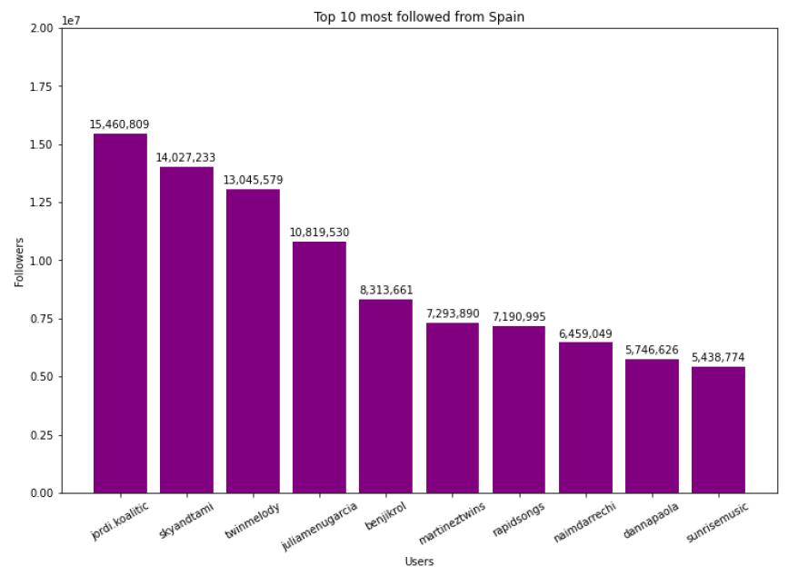
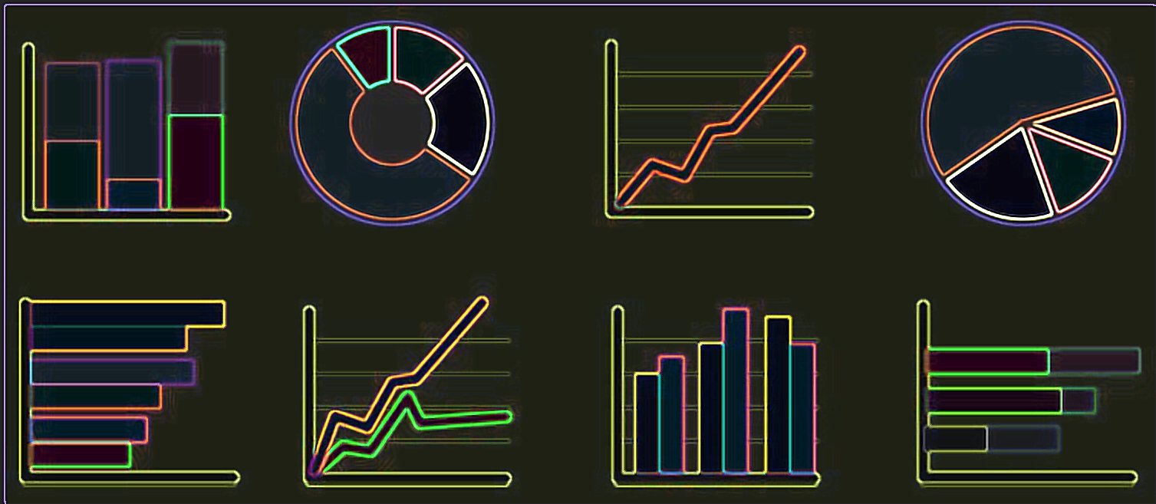
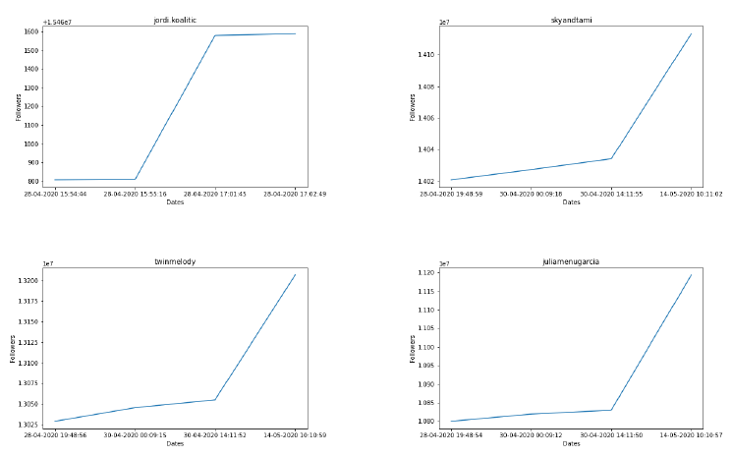
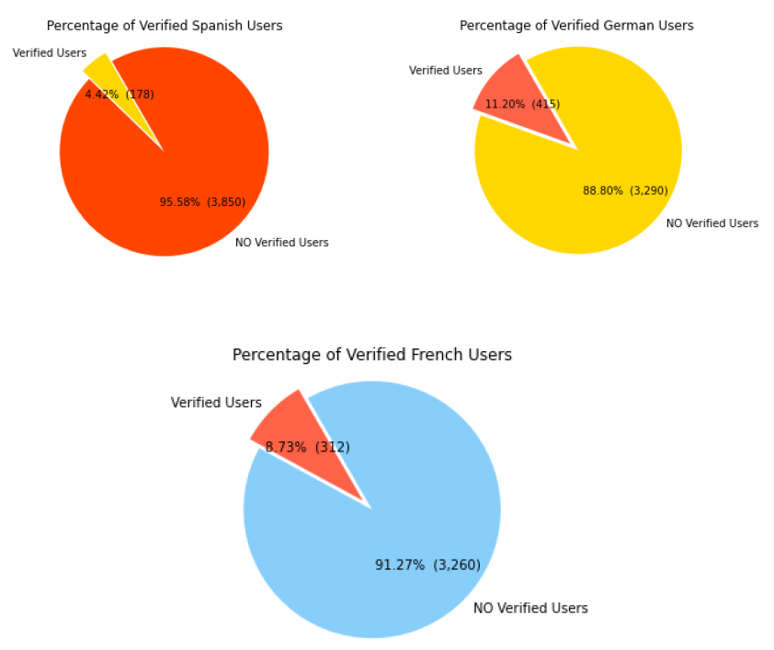
ANALYSIS
GRAPHS AND RESULTS

Slide 12
Big Data
The four stages of the information management cycle:
1º Information acquisition
The first step is finding a good source of information and the way to exploit it. One of these methods is Web Scraping (a technique that uses software programs to extract information from websites). This is the technology that we have used in our project.
2º Storage
Once the information is obtained, it is necessary to store it. Depending on the kind of information and its future using. Depending on the type of information and its future use, you can choose between different forms of storage, from spreadsheets, such as excel, or NoSQL systems that allow you to store unstructured information in a flexible and fast way. We chose MongoDB, a NoSQL data base system.
3º Management
To process the stored data, there are different types of predictive systems. You can look for repetitive patterns in the data through statistics and machine learning. In our project, we use a basic system.
In our project, we use a simple system of data representation through tables and graphs from which we draw conclusions.
4º Analysis and conclusion
Data by themselves do not guarantee knowledge, it is necessary to interpret them and understand the relationships between them. These relationships allow us to extract patterns that build knowledge about multiple domains and fields. In our case, we try to find patterns and relationships in different aspects of European culture in different countries that are part of it.
Madrid in Black​

Slide 13

Conclusion
The P.A.C.M.A.N Project
Madrid in Black

